Slide 1

CONCERT TOUR PROBLEM Optimization Method- II
Kajal Rani, Aditya Muthyala

Slide 2

AGENDA
Overview
Application of Concert Tour Optimization
Problem Statement
Algebraic Formulation
Modelling using Python
Optimal Solution
Conclusion

Slide 3

Overview
Purpose: Optimize concert tour schedules to reduce travel costs and maximize audience engagement and revenue.
Challenges: Navigate complex logistics, including managing travel routes, revenues, travel cost.
Approach: Use optimization models(Excel, Python) to create efficient and profitable tour plans.
Benefits: Improved tour efficiency leads to increased profitability and better experiences for both artists and fans.

Slide 4

Applications

Slide 5
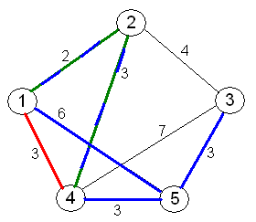
Logistics and Distribution: This is one of the primary applications where companies need to optimize the routes for delivery vehicles to minimize travel costs while maximizing revenue. For example, a delivery company could use this model to determine the most profitable sequence of stops for delivery trucks. Sales and Marketing: Companies with field sales teams use such models to plan sales tours that maximize potential sales or client visits while minimizing travel expenses and time. Airlines: For creating profitable flight routes, airlines might employ such models to determine the most profitable routes and schedules based on operational costs and expected revenues from passengers.

Slide 6

Problem Statement
“Design an optimization model that minimizes travel costs and logistical challenges for an artist's concert tour while maximizing audience reach and profitability.”

Slide 7
Algebraic Formulation

Slide 8
Decision Variables

Slide 9
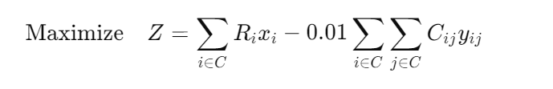
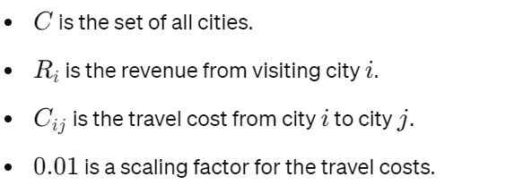
Objective Function
The goal is to maximize revenue and minimize travel costs.
where,

Slide 10
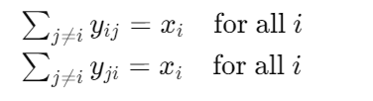
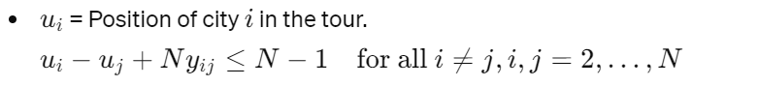
Constraints
Tour Continuity Constraint:
Subtour Elimination:

Slide 11
Modelling using Python

Slide 12
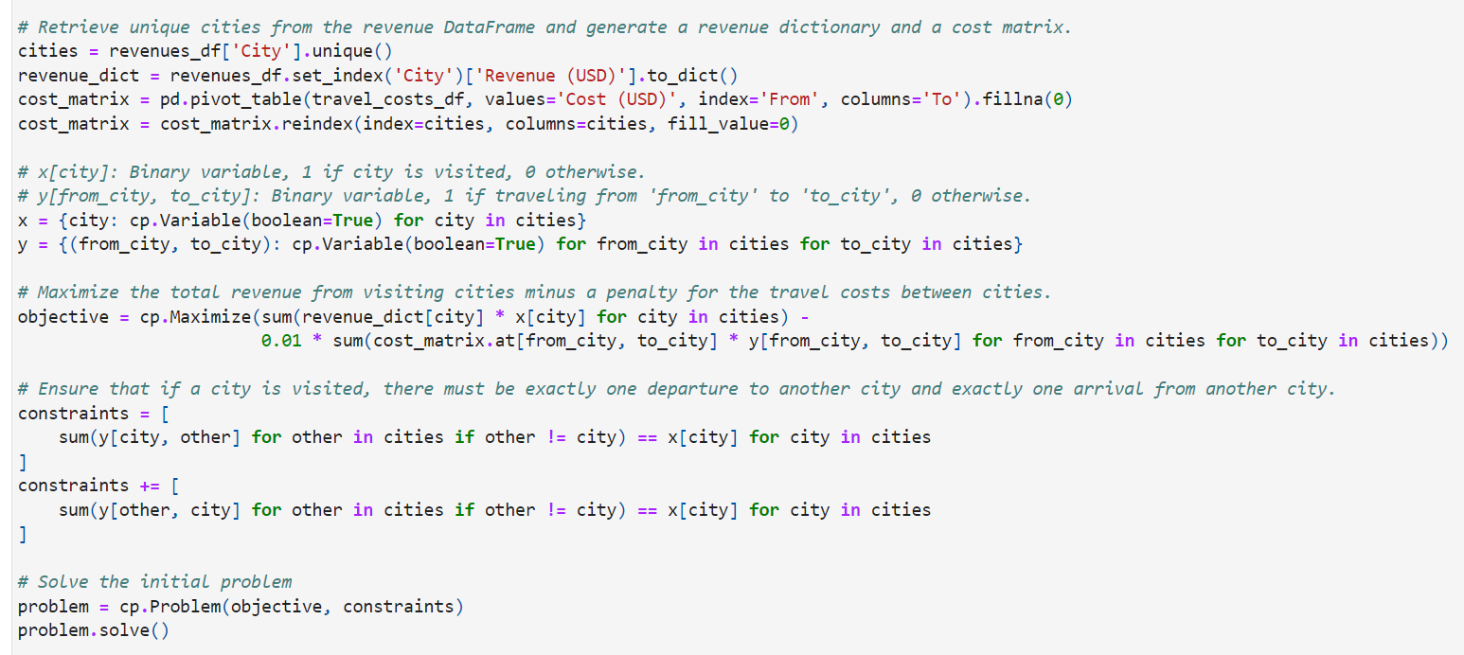
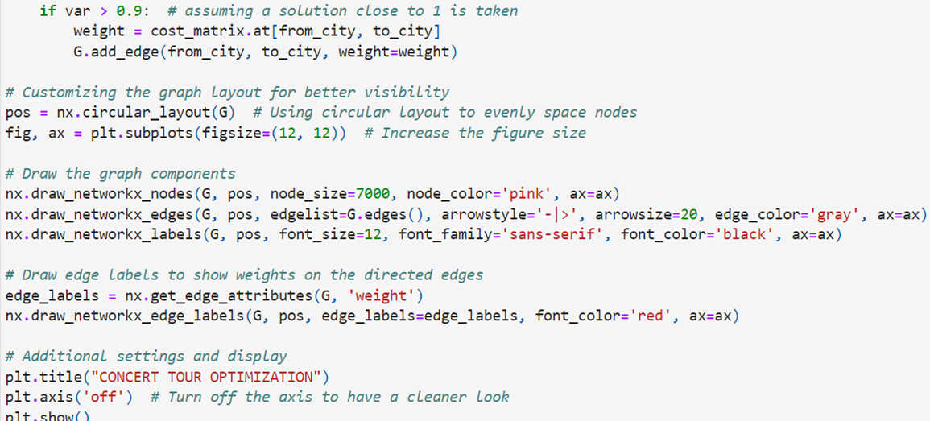

Slide 13
Optimal Solution

Slide 14
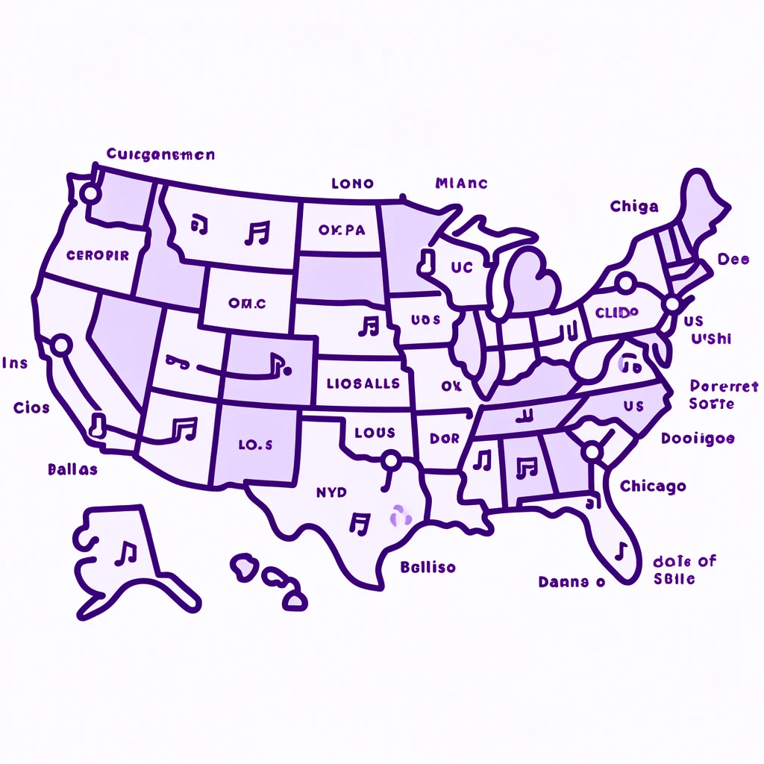
Optimal Solution
Tour sequence: [('New York', 'Chicago'), ('Los Angeles', 'San Diego'), ('Chicago', 'San Jose'), ('Houston', 'Dallas'), ('Phoenix', 'San Antonio'), ('Philadelphia', 'New York'), ('San Antonio', 'Houston'), ('San Diego', 'Phoenix'), ('Dallas', 'Philadelphia'), ('San Jose', 'Los Angeles’)]
Maximum Revenue: $157952.5

Slide 15
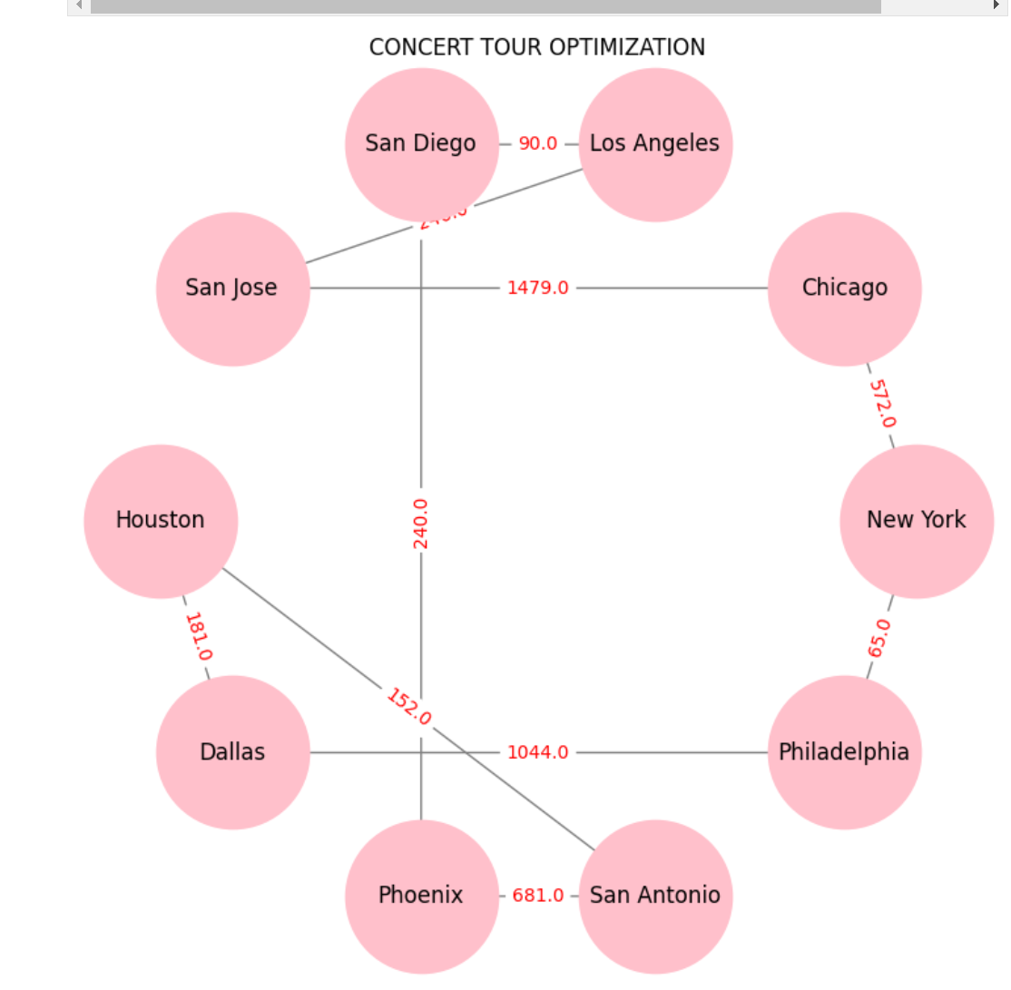
Digraph

Slide 16
Conclusion
Efficiency Improvement: Optimization models like the one used in your project significantly enhance operational efficiency by identifying the most effective routes and schedules.
Cost Reduction: These models help minimize costs associated with travel and logistics, allowing organizations to allocate resources more effectively.
Revenue Maximization: By strategically selecting locations or routes that generate the highest returns, companies can maximize their revenue potential.
Strategic Decision-Making: The integration of mathematical modeling into decision-making processes supports strategic planning and enables better long-term outcomes.

Slide 17

THANK-YOU

